Slide 1
KP Shifting Dispense Accuracy Test Report

Slide 2
Objective
The purpose of the testing was to investigate the changing dispense accuracy being experienced in the performance test KPs

Slide 3
Issue Investigation Test Points
Smart valve performance
Dispense tray components connection integrity
Power supply to critical dispense components
Problem replication on field KPs

Slide 4
Investigation - Smart Valve and Dispense Tray
Smart Valve Performance
No fuel flowing into airline during a dispense
No flooding or past issues were reported
Dispense tray components connection
All components on the dispense tray were found to be properly crimped and connected to respective PCBs.

Slide 5
Power Supply Investigation Test Points
Test effect of ethanol sensor connected/disconnected to dispense accuracy.
Test effect of powering KP from bench power supply vs mains/UPS
Test effect of powering flowmeter from Bench Power Supply(BPS)
Test effect of powering flowmeter from KP 12V DC power supply

Slide 6
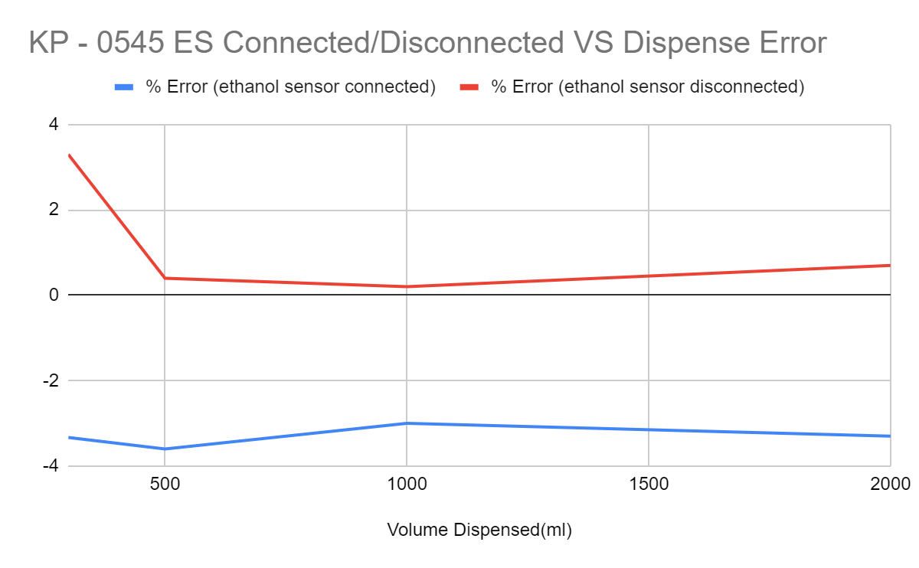
Investigation - Power Supply
Test effect of ethanol sensor connected/disconnected to dispense accuracy.
Observed trend (4 tested KPs)
Dispense error is high when sensor is connected and low when sensor is disconnected
% Error increases with decrease in tank level
% Error varies from KP to KP
TL= 110L

Slide 7
Investigation - Power Supply
2. Test effect of powering KP from bench power supply vs mains/UPS.
Tests on KP - 0550
 | % Error in dispense
Dispensed Vol (ml) | Mains | 13.5V Power Supply
1000 | -1.40% | -1.45%
2000 | -1.13% | -1.00%
Observations
Negligible change in dispense accuracy

Slide 8
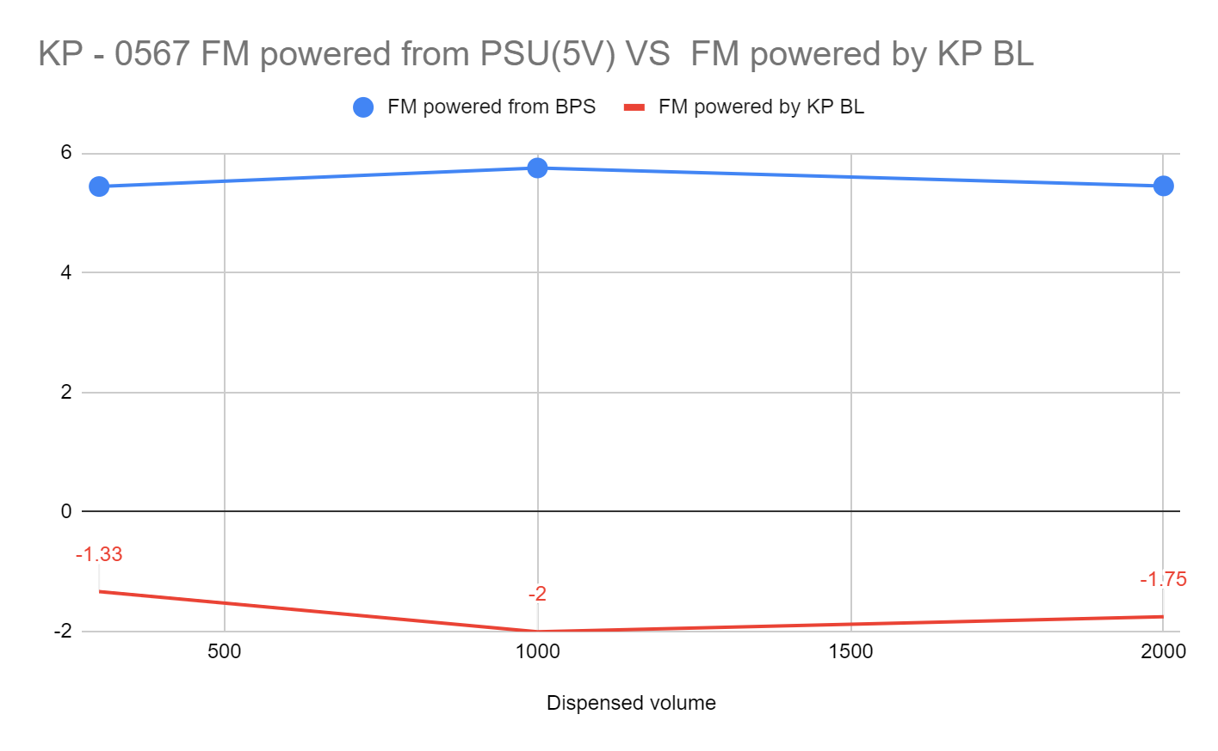
Investigation - Power Supply
3. Test effect of powering flowmeter from Bench Power Supply(BPS).
FM powered externally from 5V BPS
Observed trend (tested on 2 KPs)
Dispense volume significantly increases when KP is powered from BPS
Ethanol sensor connection or disconnection has negligible effect when FM is powered by BPS
FM= Flowmeter BL = Below Left

Slide 9
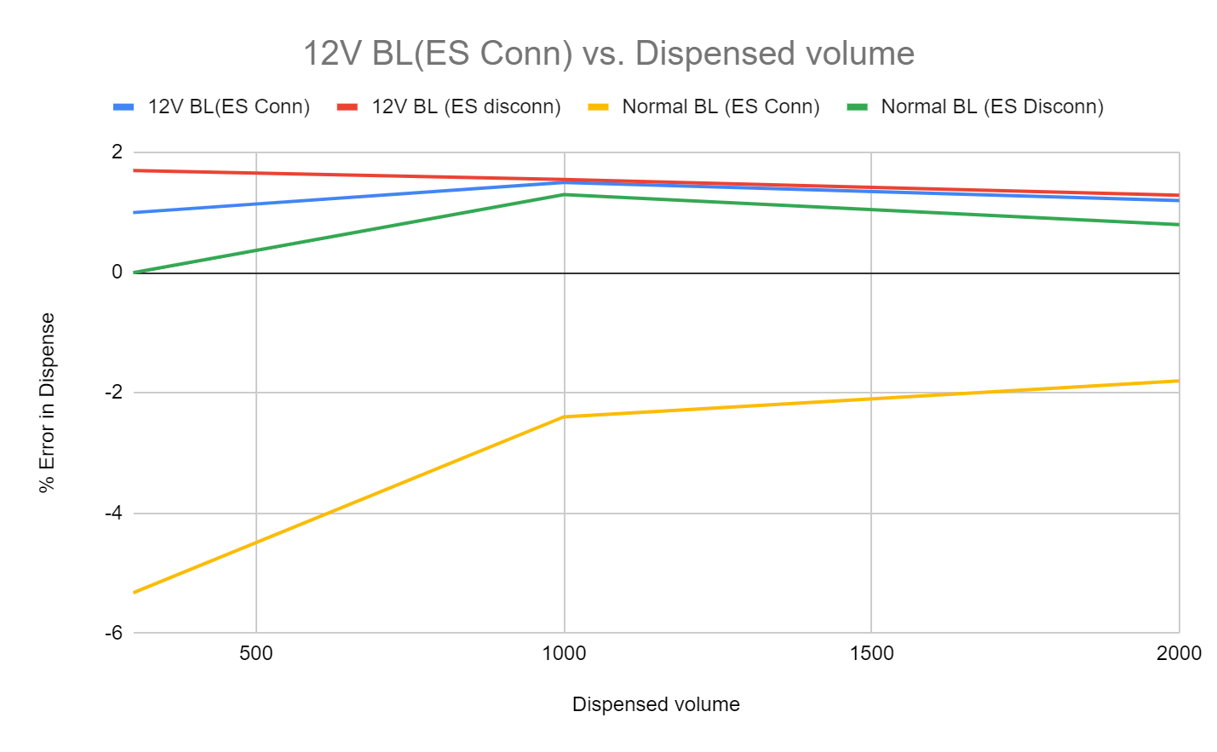
Investigation - Power Supply
4. Test effect of powering flowmeter from KP 12V DC power supply.
New BL PCB with 12V FM supply used
Observed trend (tested on 2 KPs)
Dispense volume significantly increases when KP FM is powered by 12V compared to normal 5V
12V BL setup has higher dispense volumes compared to normal KP BL
Ethanol sensor connection or disconnection has negligible effect when FM is powered by12V BL
ES = Ethanol sensor BL = Below Left PCB

Slide 10
Investigation - Problem Replication
Test performance of field KPs.
 |  |  | Sensor Connected | Sensor Disconnected
 |  | Vol Dispensed(ml) | Error (%) | Error (%)
KP - 0821 | TL>200L | 300 | 0.40% | 0.37%
 |  | 1000 | 0.15% | 0.06%
 |  | 2000 | 1.00% | 0.07%
 |  |  | Sensor Connected | Sensor Disconnected
 |  | Vol Dispensed(ml) | Error (%) | Error (%)
KP - 0438 | TL=191 | 300 | -0.67% | 0.33%
 |  | 1000 | 0.08% | 0.10%
 |  |  | Sensor Connected | Sensor Disconnected
 |  | Vol Dispensed(ml) | Error (%) | Error (%)
KP - 0030 (KOKOplex) | TL=110 | 2000 | 0.00% | 0.00%
Field KPs dispense accuracy measured with the ES sensor connected/disconnected
Observed trend ( 7 KPs)
Connection and disconnection of ES has negligible effect to dispense accuracy.
None of the visited KPs has dispensed more than 600L.

